Slide 1
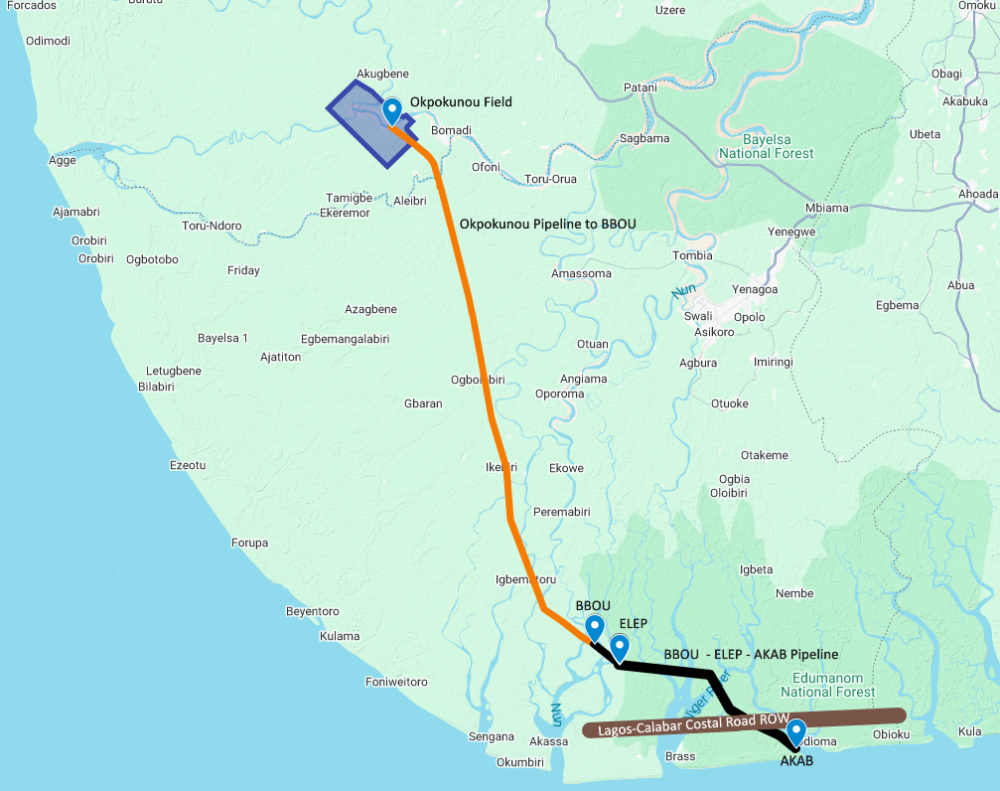
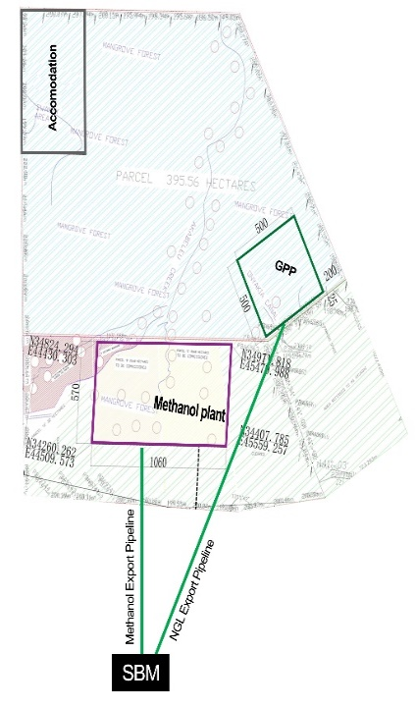

RAEC 200 MMscfd Gas Supply From OKNU For The DSV Gas Hub Alongside RAEC Phase-1 GSPA 270 MMscfd Gas Supply to the BFPCL Gas Processing Plant
Facilities West of River Niger
Facilities East of River Niger
OKNU
SITE PLAN
200 MMscfd
6
OKNU
CF-MF
Slug
Catcher
Slug Catcher Concept Provision, c/w: Liquid Processing / Water Disposal System.
(Located at OKNU or BBOU or ELEP), or at AKAB, subject to benefit analysis
20” x 85km OKNU-BBOU Gas Pipeline:
Capacity of 200 MMscfd or 270, if the make-up gas will come from OKNU
OKNU Manifold
20” x 85km OKNU-BBOU P/L
BBOU Manifold
24” x 8km BBOU-ELEP P/L
ELEP Manifold
30” x 32km ELEP-AKAB P/L
PLEM at AKAB
2
ELEP
180 MMscfd
CTP
1
BBOU
331 MMscfd
M
Gas Processing Facility (at Akabel)
CTP
ELEP
E-MF
M
470 MMscfd
Gas Processing
Facility (60 barg)
500 MMscfd
Gas
BFPCL Methanol Plant
BBOU S-MF
24” x 8km
540 MMscfd
Pipeline diameters are provisional, pending FP Survey of new Pipeline Route, and update of the existing Pipeline Route
30’’ x 32km
Slug
Catcher
P/L Scope Limit
Gas
IPP
Pressure required at Gas Plant inlet: 60 barg
GPP Liquid Processing / Water Disposal System
Brass FLNG
NGL
NGL
NGL Storage Tanks
NGL Export Jetty
(at Akabel)
Condensate
Condensate
Condensate
Condensate
Storage Tanks
Condensate Export
Jetty (at Akabel)

Slide 2
Pipeline Scope Limit Definition & Tie-in Point to GPP Inlet (Slug Catcher)
From OKNU 200 MMscfd
(270 MMsfd, if the make–up of 70 MMscfd comes from OKNU
~
~
1
BBOU
331 MMscfd
CTP
20” x 85km
M
2
ELEP
180 MMscfd
BBOU
S-MF
M
CTP
470 MMscfd
ELEP
E-MF
24” x 8km
Gas Processing Facility (at Akabel)
540 MMscfd
Pig Receiver
Gas Processing
Facility (60 barg)
500 MMscfd
Gas
BFPCL Methanol Plant
30’’ x 32km
Slug
Catcher
Gas
IPP
P/L Scope Limit
Fertilizer / FLNG
GPP Liquid Processing / Water Disposal System
NGL
NGL
NGL Storage Tanks
NGL Export Jetty
(at Akabel)
Condensate
Condensate
Condensate
Condensate
Storage Tanks
Condensate Export
Jetty (at Akabel)

